Slide 1
Fundus Image Analysis and Grading
for Diabetic Retinopathy
Team: Pooja Krishnan, Veronika Kotova, Shraddha Beedu, Ali Kareem Raja
Tutor: Hasan Sarhan

Slide 2
Problem Statement
Proposed Approach
Recap
Two Eye / One Eye Approach
Integration
End to End Training
Results
Impediments
Agenda

Slide 3
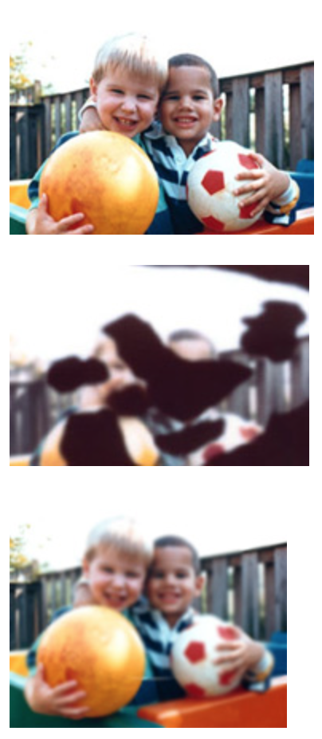
Problem statement
Diabetic retinopathy (DR)
Leading cause of vision loss in the general population
Affects up to 80 % of people who have had diabetes for 20 years or more
Challenges
Detecting the subtle pathological lesion characteristic of early-stage disease
No large well annotated datasets
Source: https://nei.nih.gov/health/diabetic/retinopathy, accessed on 11.12.2018

Slide 4
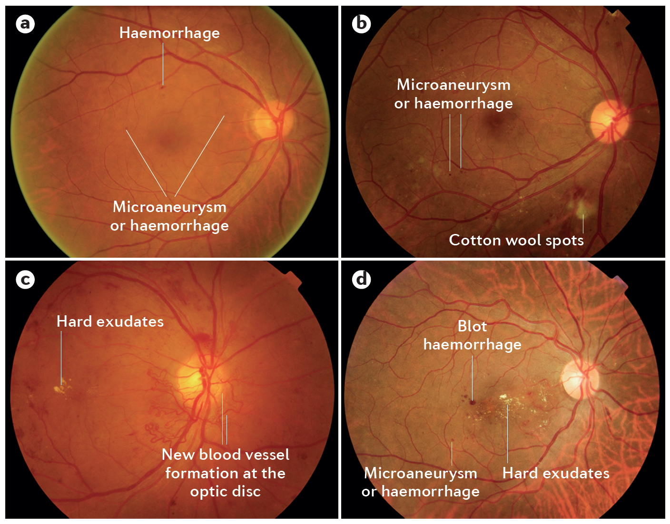
Proposed approach
Goal
Convolutional Neural Network based algorithm for:
diagnosing 5 stages of DR
highlight suspicious regions
DR stages
0 – no DR
1 – mild
2 – Moderate
3 – Severe
4 – Proliferative
Datasets
EyePACS
IDRiD
Source: T.Y. Wong, C.M. Cheung, M. Larsen, S. Sharma, and R. Simó. Diabetic retinopathy, 16012. Nature Reviews Disease Primers, 2016

Slide 5
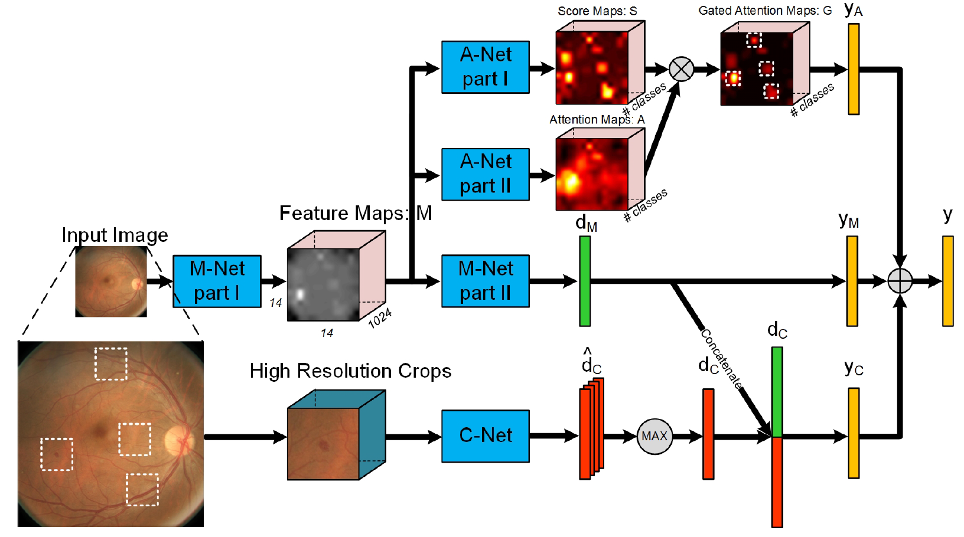
Architecture ( Zoom-in Net)
Source: Z.Wang, Y.Yin, J.Shi, W.Fang, H.Li, and X.Wang. Zoom-in-Net: Deep Mining Lesions for Diabetic Retinopathy Detection, pages 267–275. Springer International Publishing, 2017

Slide 6
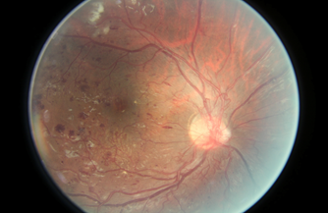
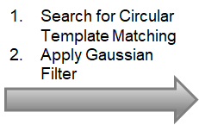
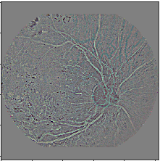
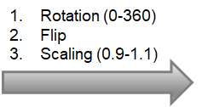
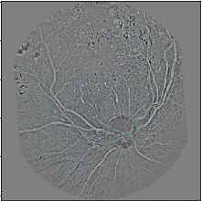
Remove this

Slide 7

Main Network (M-Net)
Source: Z.Wang, Y.Yin, J.Shi, W.Fang, H.Li, and X.Wang. Zoom-in-Net: Deep Mining Lesions for Diabetic Retinopathy Detection, pages 267–275. Springer International Publishing, 2017

Slide 8
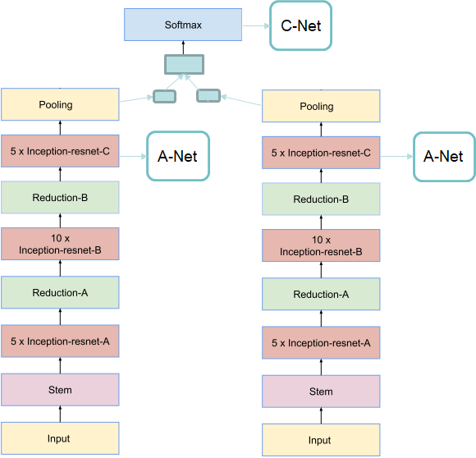
Main Network (M-Net)
•Input : Pre-processed images of size 512x512
•Output: Probability of the image belonging to each disease level
•Output from layer 5xIncepetion-resnet-C is taken as input for A-Net.
•Concatenate the left and right eye for classification.
•Weighted loss computation

Slide 12
Attention Network (A-Net)
Source: Z.Wang, Y.Yin, J.Shi, W.Fang, H.Li, and X.Wang. Zoom-in-Net: Deep Mining Lesions for Diabetic Retinopathy Detection, pages 267–275. Springer International Publishing, 2017

Slide 13
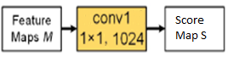
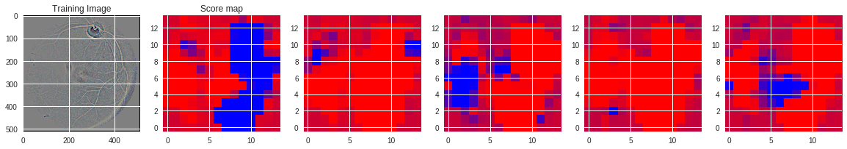
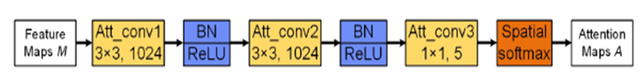
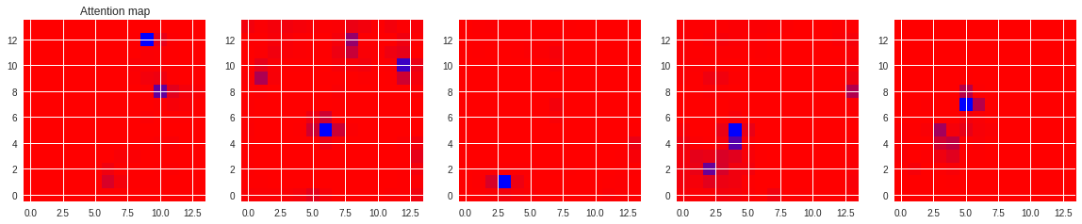
Attention Network (A-Net)

Slide 14
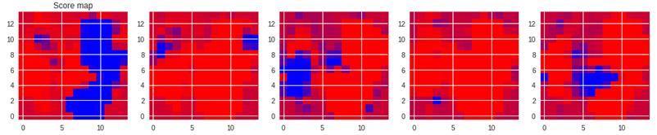
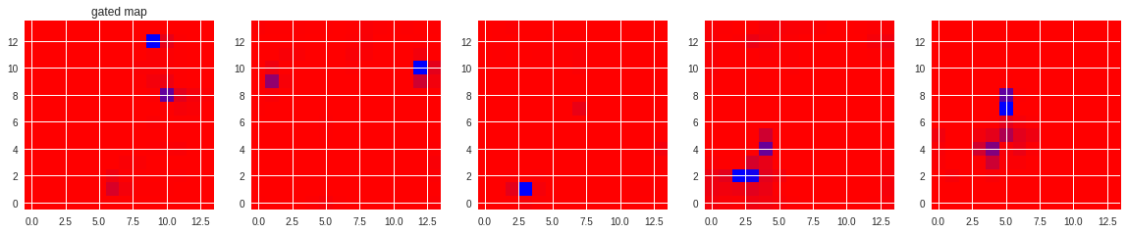
Gated map

Slide 15
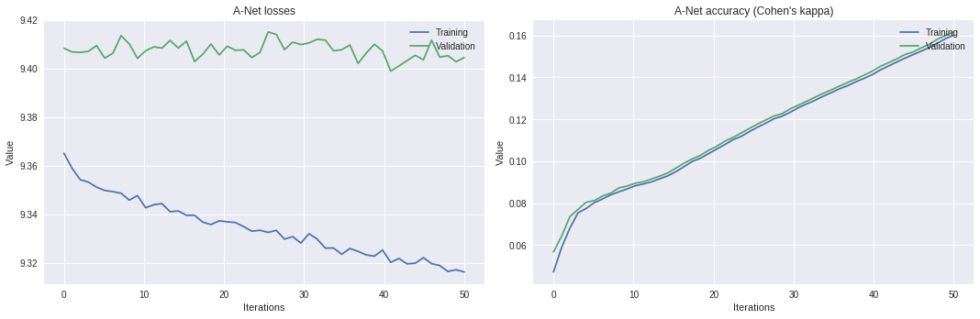
A-Net with 2-eye M-Net
Weighted SoftMax Cross Entropy Loss (with L2 regularization) : 9.30
Kappa Score :0.16

Slide 16
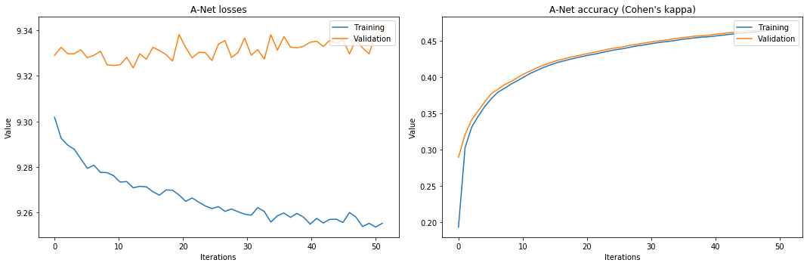
A-Net with 1-eye M-Net Model
Weighted SoftMax Cross Entropy Loss (with L2 regularization) : 9.25
Kappa Score :0.48

Slide 17
Crop Network ( C-Net )
Source: Z.Wang, Y.Yin, J.Shi, W.Fang, H.Li, and X.Wang. Zoom-in-Net: Deep Mining Lesions for Diabetic Retinopathy Detection, pages 267–275. Springer International Publishing, 2017

Slide 18
Recap: Initializing Inception
Approach:
Retrain all layers
Using TF-Slim implementation
Create TF-Records of all images then train
Result:
Trained the network up to 20k steps
We have an initialized model for training with accuracy of 92% and loss of 0,70

Slide 19
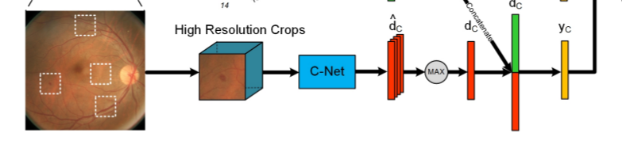
Crop Network ( C-Net )
Input
Attention Maps acquired from A-Net
Gated Maps from A-Net stored into a dictionary, written into a binary file.
C-Net reads the binary file.

Slide 20
Crop Network ( C-Net )
Process
Zooming-in suspicious attention regions
Record the highest response in the attention map and crop the region
Mask the region around the crop to avoid re-selection
Repeat until total of N-coordinates are recorded

Slide 21
Crop Network ( C-Net )
Output
For all the crops of the same eye, take an element wise max

Slide 22
Crop Network ( C-Net )
Output
For all the crops of the same eye, take an element wise max

Slide 23
Integration
Planned:
Initially planned on a single training pipeline for all 3 Neural Nets
Unfeasible due to highly coupled nature of project
Implementation:
Write each component independently
Write output of each component into a binary file
Saved checkpoints of each component used to get feature maps

Slide 25
End to End Training

Slide 26
Impediments
Google Colab with multiple experiments, time out issues
Very small amount of data
Microaneurysms and Haemorrhages are almost indistinguishable
Inconsistent labeling in EyePACS dataset

Slide 27
Topics:
Problem Statement
Proposed Approach
Architecture
Preprocessing
Results
Future Roadmap
Questions?

Slide 28
Thank You

